Slide 1
CAP615 PROGRAMMING IN JAVA
Presented by
Kumar Vishal

Slide 2
Introduction to Java
working with arrays and strings,
String,
StringBuffer and
StringBuilder classes

Slide 3
Array
Array is a collection of similar type of elements that have contiguous memory location.
In java, array is an object the contains elements of similar data type.
It is a data structure where we store similar elements. We can store only fixed elements in an array.
Array is index based, first element of the array is stored at 0 index.

Slide 4
Advantage of Array
Code Optimization: It makes the code optimized, we can retrieve or sort the data easily.
Random access: We can get any data located at any index position.
Disadvantage of Array
Size Limit: We can store only fixed size of elements in the array. It doesn't grow its size at runtime. To solve this problem, collection framework is used in java.

Slide 5
Types of Array: There are two types of array.
Single Dimensional Array
Multidimensional Array-
2D array
3D array
Jagged array

Slide 6
Single Dimensional Array
The syntax for declaring and instantiating an array:
There are two ways to declare an array,
type[] arrayName;
type arrayName[];

Slide 7
How to instantiate an array
arrayName = new type[length];
How to declare and instantiate an array in one statement
type[] arrayName = new type[length];

Slide 8
Examples
Array of integers
int[] num = new int[5];
Array of Strings
String[] nameList = new String[5];
nameList[0] = "Amanda Green";
nameList[1] = "Vijay Arora";
nameList[2] = "Sheila Mann";
nameList[3] = "Rohit Sharma";
nameList[4] = "Mandy Johnson";

Slide 9
Enhanced For loop
for(data_type variable : array | collection)
{
//body of for-each loop
}

Slide 10
Example:
int []myArray=new int[]{11,12,13,14,15};
for(int num : myArray)
{
System.out.print(num+”,”);
}
Out put: 11,12,13,14,15

Slide 11
Array length
The syntax for getting the length of an array
arrayName.length
e.g-
int[] values = new int[10];
for (int i = 0; i < values.length; i++)
{
}

Slide 12
Two-dimensional arrays
The syntax for creating a rectangular array-
type[][] arrayName = new type[rowCount][columnCount];
A statement that creates a 3x2 array
int[][] numbers = new int[3][2];
3x2 array and initializes it in one statement
int[][] numbers =new int[][] { { 1, 2 }, { 3, 4 }, { 5, 6 } };

Slide 13
Enhanced for loop for 2D array
for (int[] num: arr)
{
for(int data: num)
{
System.out.println(data);
}
}

Slide 14
Jagged array
type[][] arrayName = new type[rowCount][];
e.g:-int num[][]=new int[4][];
num[0]=new int[1];
num[1]=new int[2];
num[2]=new int[3];
num[3]=new int[4];

Slide 15
3D array:
Syntax:
array_type[][][] array_name = new array_type[x][y][z];
Ex:
int[][][] num=new int[2][3][4];
Here, num[i][j][k] where ‘i’ is the array number, ‘j’ is the row number and ‘k’ is the column number.

Slide 16
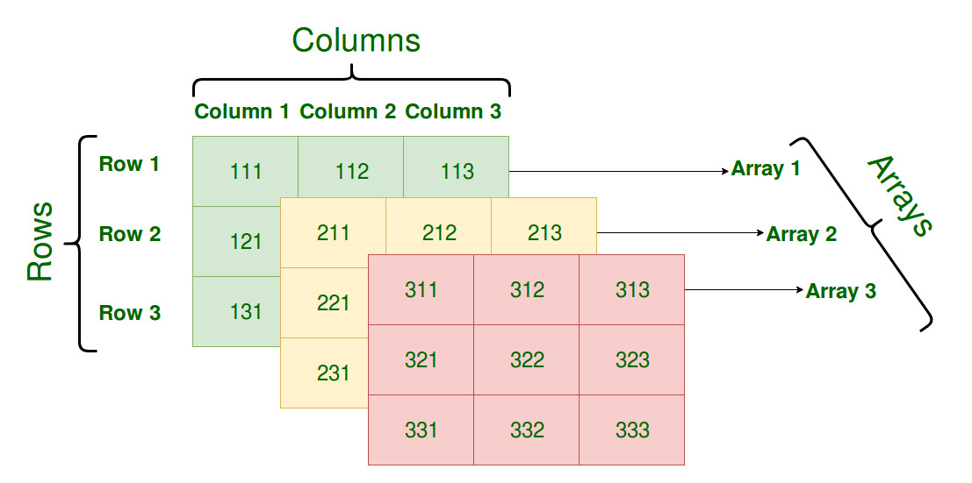
int[][][] num=new int[3][3][3];

Slide 17
For example find exam scores obtained by three students of each department in 3 different subjects.

Slide 18
Electronics department:
student1 scores: 75, 87, 69
student2 scores: 90, 87, 85
student3 scores: 56, 67, 76
Computer Science department:
student1 scores: 78, 67, 75
student2 scores: 87, 98, 76
student3 scores: 67, 56, 65
Information Technology department:
student1 scores: 72, 63, 72
student2 scores: 82, 91, 71
student3 scores: 64, 56, 66
To store all these exam scores, department-wise,
we will need to use three-dimensional array
int[ ][ ][ ] scores = new int[3][3][3];

Slide 19
4 D Array
Array of 3 D Array
int [][][][] num=new int[2][2][2][2];
Multi dimensional array means array of arrays.

Slide 20
String Class
String is a sequence of characters.
if we want to store a group of characters we can use a char array. For example: char name[] = new char[10]; But here size is fixed.
But in Java, string is an object that represents a sequence of characters.
The java.lang.String class is used to create a string object.
In java, String objects are immutable which means a constant and cannot be changed once created.

Slide 21
How to create an object for String in Java?
To create an object for String class we have the following two ways:
Using string literal
Using a new keyword

Slide 22
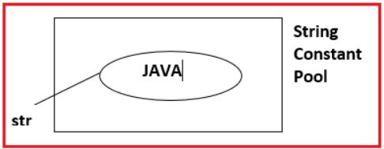
Using string literal
In java, Strings can be created by assigning a string literal to a String instance:
Example: String str =”Java”;
When we create String objects using a string literal directly then the string object is created inside a special memory area called String Constant Pool.
Java String pool refers to a collection of Strings that are stored in heap memory

Slide 23
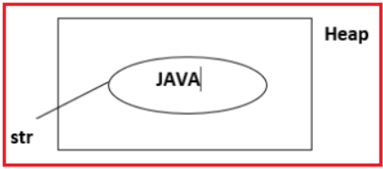
Using a new keyword
When we create a String object using a new operator then a string object is created inside Heap memory.
Example: String str = new String(“Java”);

Slide 24
string literal:
kumar
s
string constant pool
String s=“kumar";
Each time you create a string literal, the JVM checks the "string pool" first. If the string already exists in the pool, a reference to the pooled object is returned. If the string doesn't exist in the pool, a new string object is created and placed in the pool.
String s1=“kumar";
String s2=“kumar";
//It doesn't create a new string object
s1
kumar
s2
string constant pool

Slide 25
Concept:---
S
String s1=“kumar”
String s2=“kumar”
String s3= “Rahul”
s1
kumar
Rahul
s2
String s4=new String(“kumar”)
s3
string constant pool
s1==s2 // true
s1==s3//false
s1==s4//false
s4
kumar
Heap
Note:- Here s1,s2,s3 and s4 are references of string object kumar, Rahul, kumar

Slide 26
string is immutable in java:
Immutable Objects in Java
String Objects can be created either by using a new operator or by using string Literal directly. In both, cases String objects are created as Immutable Objects.

Slide 27
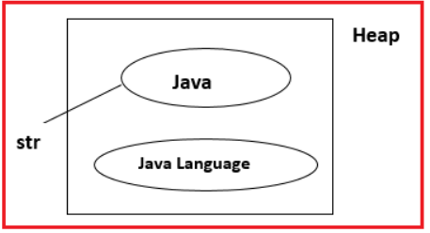
String str = new String(“Java”); System.out.println(str); //Java System.out.println(str.concat(“Language”));
// Java Language System.out.println(str); //Java

Slide 28
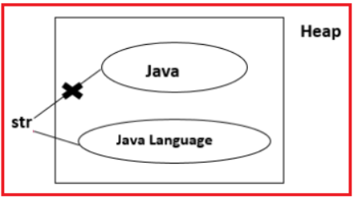
Example: String str = new String(“Java”); System.out.println(str); //Java str = str.concat(“Language”); System.out.println(str); //Java Language

Slide 29
Why String Objects are given as Immutable Objects in Java?
Sometimes an object can be referred to by multiple reference variables in this case if string objects are mutable objects then if we change the content of the object then automatically other references get also modified so that string Objects are given as Immutable Objects, it means whenever any operation is done on Strings it will create a new object.

Slide 30
Methods in String class:
length(),
charAt()
substring()
concat()
indexOf()
equals()
compareTo()
trim()
replace()
toUpperCase()
toLowerCase();

Slide 31
length(), charAt()
int length();
char charAt(i);
Returns the number of characters in the string
Returns the char at position i.
Character positions in strings are numbered starting from 0 – just like arrays.
Returns:
”Problem".length();
”Window".charAt (2);
7
’n'

Slide 32
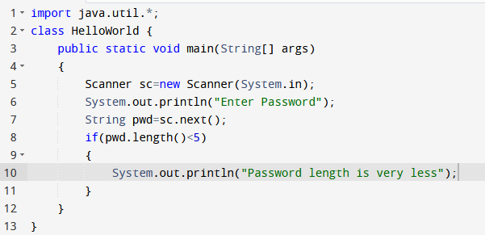


Slide 33
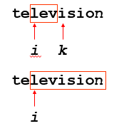
substring()
Returns a new String by finding characters from an existing String.
String subs = word.substring (i, k);
returns the substring of chars in positions from i to k-1
String subs = word.substring (i);
returns the substring from the i-th char to the end
”television".substring (2,5);
“immutable".substring (2);
“lev"
“mutable"

Slide 34
Concatenation()
String word1 = “re”, word2 = “think”; word3 = “ing”;
int num = 2;
String result = word1.concat (word2);
//the same as word1 + word2 “rethink“

Slide 35
indexOf()
index positions
String name =“President George Washington";
name.indexOf (‘P'); 0
name.indexOf (‘e'); 2
name.indexOf (“George"); 10
name.indexOf (‘e', 3) 6
name.indexOf (“Bob"); -1
indexOf():
The indexOf() method returns the position of the first occurrence of specified character(s) in a string.
Returns:
(starts searching at position 3)
(not found)
Notes:
String has four overloaded versions of indexOf and four versions of lastIndexOf.
lastIndexOf(ch, fromPos) starts looking at fromPos and goes backward towards the beginning of the string.

Slide 36
equals()/equalsIgnoreCase()
boolean b = word1.equals(word2);
returns true if the string word1 is equal to word2
boolean b = word1.equalsIgnoreCase(word2);
returns true if the string word1 matches word2, case-blind
b = “Raiders”.equals(“Raiders”);//true
b = “Raiders”.equals(“raiders”);//false b = “Raiders”.equalsIgnoreCase(“raiders”);//true
Notes:
You cannot use relational operators for comparing the contents of strings.
word1.compareTo(word2) returns an int. Basically if word1 is “smaller” than word2, the result is negative, and if word1 is “larger” the result is positive. compareTo returns 0 whenever equals returns true.
Here is how Java docs describe compareTo:
Compares two strings lexicographically. The comparison is based on the Unicode value of each character in the strings. The character sequence represented by this String object is compared lexicographically to the character sequence represented by the argument string. The result is a negative integer if this String object lexicographically precedes the argument string. The result is a positive integer if this String object lexicographically follows the argument string. The result is zero if the strings are equal; compareTo returns 0 exactly when the equals(Object) method would return true.
This is the definition of lexicographic ordering. If two strings are different, then either they have different characters at some index that is a valid index for both strings, or their lengths are different, or both. If they have different characters at one or more index positions, let k be the smallest such index; then the string whose character at position k has the smaller value, as determined by using the < operator, lexicographically precedes the other string. In this case, compareTo returns the difference of the two character values at position k in the two string — that is, the value:
this.charAt(k)-anotherString.charAt(k)
If there is no index position at which they differ, then the shorter string lexicographically precedes the longer string. In this case, compareTo returns the difference of the lengths of the strings — that is, the value:
this.length()-anotherString.length()

Slide 37
Difference between == and .equals() method in Java
equals() is a method and == is a operator
use == operators for reference comparison (address comparison) and .equals() method for content comparison.
In simple words, == checks if both objects point to the same memory location whereas .equals() evaluates to the comparison of values in the objects

Slide 38
compareTo()
int diff = word1.compareTo(word2);
returns the “difference” word1 - word2
if string1 > string2, it returns positive number
if string1 < string2, it returns negative number
if string1 == string2, it returns 0
The java string compareTo() method compares the given string with current string . It returns positive number, negative number or 0.
It compares strings on the basis of Unicode value of each character in the strings.
Notes:
You cannot use relational operators for comparing the contents of strings.
word1.compareTo(word2) returns an int. Basically if word1 is “smaller” than word2, the result is negative, and if word1 is “larger” the result is positive. compareTo returns 0 whenever equals returns true.
Here is how Java docs describe compareTo:
Compares two strings lexicographically. The comparison is based on the Unicode value of each character in the strings. The character sequence represented by this String object is compared lexicographically to the character sequence represented by the argument string. The result is a negative integer if this String object lexicographically precedes the argument string. The result is a positive integer if this String object lexicographically follows the argument string. The result is zero if the strings are equal; compareTo returns 0 exactly when the equals(Object) method would return true.
This is the definition of lexicographic ordering. If two strings are different, then either they have different characters at some index that is a valid index for both strings, or their lengths are different, or both. If they have different characters at one or more index positions, let k be the smallest such index; then the string whose character at position k has the smaller value, as determined by using the < operator, lexicographically precedes the other string. In this case, compareTo returns the difference of the two character values at position k in the two string — that is, the value:
this.charAt(k)-anotherString.charAt(k)
If there is no index position at which they differ, then the shorter string lexicographically precedes the longer string. In this case, compareTo returns the difference of the lengths of the strings — that is, the value:
this.length()-anotherString.length()

Slide 39
Comparison Examples
//negative differences
diff = “apple”.compareTo(“berry”);//a before b
diff = “Zebra”.compareTo(“apple”);//Z before a
diff = “dig”.compareTo(“dug”);//i before u
diff = “dig”.compareTo(“digs”);//dig is shorter
//zero differences
diff = “apple”.compareTo(“apple”);//equal
diff = “dig”.compareToIgnoreCase(“DIG”);//equal
//positive differences
diff = “berry”.compareTo(“apple”);//b after a
diff = “apple”.compareTo(“Apple”);//a after A
diff = “BIT”.compareTo(“BIG”);//T after G
diff = “huge”.compareTo(“hug”);//huge is longer

Slide 40
Methods — Changing Case
String word2 = word1.toUpperCase();
String word3 = word1.toLowerCase();
returns a new string formed from word1 by converting its characters to upper (lower) case
String word1 = “HeLLo“;
String word2 = word1.toUpperCase();//”HELLO”
String word3 = word1.toLowerCase();//”hello”
//word1 is still “HeLLo“
Notes:
Note that these methods do not change the string word1 but create and return a new string.
trim() only removes whitespace at the ends of the string, not in the middle.

Slide 41
trim()
removing white space at both ends
does not affect whites space in the middle
Example:
String word1 = “ Hi Kumar “;
String word2 = word1.trim();
//word2 is “Hi Kumar” – no spaces on either end
//word1 is still “ Hi Kumar “ – with middle spaces
Notes:
Note that these methods do not change the string word1 but create and return a new string.
trim() only removes whitespace at the ends of the string, not in the middle.

Slide 42
replace()
method returns a string replacing all the old char or CharSequence to new char or CharSequence.
Syntax:
String replace(char oldChar, char newChar)
String replace(CharSequence target, CharSequence replacement)
Example:
String str1="hello hello hello";
String str2="hello hello hello";
str1=str1.replace('h', 'H');
str2=str2.replace("hello", "hi");
System.out.println(str1);
System.out.println(str2);
Notes:
Note that these methods do not change the string word1 but create and return a new string.
trim() only removes whitespace at the ends of the string, not in the middle.

Slide 43
replaceAll()
The java string replaceAll() method returns a string replacing all the sequence of characters matching regular expression and replacement string.
Syntax: String replaceAll(String regex, String replacement)

Slide 44
Example:
replace all occurrences of white spaces in a string:
String str = "how to do in java provides java reading materials";
String newStr = str.replaceAll(“\\s", "");
System.out.println(newStr);

Slide 45
StringBuffer class
StringBuffer is mutable means one can change the value of the object .
The object created through StringBuffer is stored in the heap .
each method in StringBuffer is synchronized that is StringBuffer is thread safe due to this it does not allow two threads to simultaneously access the same method . Each method can be accessed by one thread at a time .

Slide 46
Differences between StringBuffer and StringBuilder
StringBuffer | StringBuilder
StringBuffer is synchronized i.e. thread safe. It means two threads can't call the methods of StringBuffer simultaneously. | StringBuilder is non-synchronized i.e. not thread safe. It means two threads can call the methods of StringBuilder simultaneously.
StringBuffer is less efficient than StringBuilder. | StringBuilder is more efficient than StringBuffer.

Slide 47
methods of StringBuffer/StringBuilder class
append()
capacity()
ensureCapacity()
insert()
reverse()
replace()
length()
delete()
deleteCharAt()
substring()

Slide 48
append()
is used to append the string from one string to another string like concat.
Syntax:
StringBufferClassReference.append(any type)
Any type:-
append(char), append(boolean), append(int), append(float), append(double) etc.

Slide 49
capacity()
is used to return the current capacity of buffer.
The default capacity of the buffer is 16.
If the number of character increases from its current capacity, it increases the capacity by (oldcapacity*2)+2.
For example if your current capacity is 16, it will be (16*2)+2=34.

Slide 50
Condition1:
StringBuffer sb=new StringBuffer();
System.out.println("Current Capacity:"+sb.capacity());
// Current Capacity:16
Condition2:
StringBuffer sb=new StringBuffer(“hello”);
System.out.println("Current Capacity:"+sb.capacity());
// Current Capacity:21

Slide 51
ensureCapacity()
It ensures that the given capacity is the minimum to the current capacity. If it is greater than the current capacity, it increases the capacity by (oldcapacity*2)+2.
Ex:
If current capacity is:70
sb.ensureCapacity(70); // no change
But
sb.ensureCapacity(71); // cahnge now 142

Slide 52
insert(),reverse()
insert():It is used to inserts the string at the specified position.
Syntax:
StringBufferClassReference.insert(pos,string)
It is used to reverses the current string
Syntax:
StringBufferClassReference.reverse()
reverse()

Slide 53
replace():
replaces the string from the specified startingIndex and endingIndex.
Syntax:
StringBufferClassReference.replace(startingIndex, endingIndex, newstring)
e.g:
StringBuffer sb=new StringBuffer("Hello");
sb.replace(1,3,“kumar");
System.out.println(sb);//Hkumarlo

Slide 54
length() : to find the length of current string
Syntax:
StringBufferClassReference.length()
delete(): deletes the string from the specified startingIndex to endingIndex.
Syntax:StringBufferClassReference.delete(startingIndex,endingIndex)
e.g:
StringBuffer sb=new StringBuffer("Hello");
sb.delete(1,3);
System.out.println(sb);//Hlo

Slide 55
deleteCharAt():
deletes the character at the index specified by loc.
Syntax:
StringBufferClassReference.deleteCharAt(int loc)
e.g:
StringBuffer sb=new StringBuffer("Hello");
sb.deleteCharAt(3);
System.out.println(sb);//Helo

Slide 56
substring()
is used to return the substring from the specified startingIndex and endingIndex.
Syntax:
substring(int startingIndex, int endingIndex)

Slide 57
Any Query??

